Slide 1
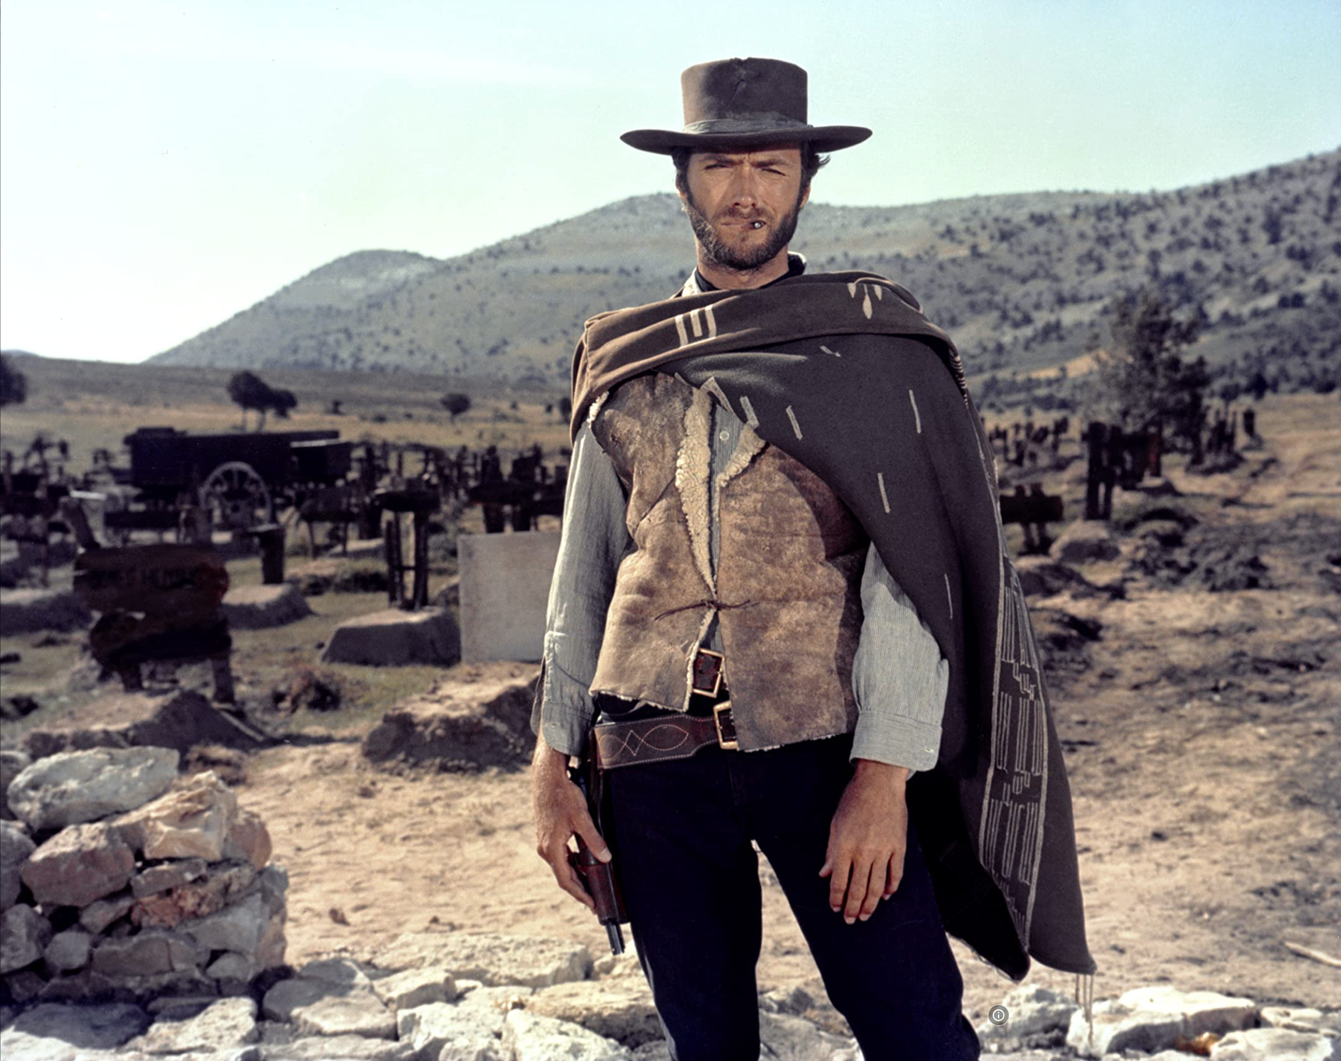

The Easy, the Hard and the Ugly
Easy
Inference (fit)
Fine-Tuning (predict)
Hard
Pre-training
Ugly (Responsible AI)
Bias
Toxicity
Misinformation
Hallucinations
Plagiarism

Slide 2
Easy - IR
Inverted index solutions
Elastic Search, Solr, Lucene
SQL-contains
Basic multilingual support
Out-of-the-box ranking
Available UX frameworks
Lots of open-source solutions
APIs

Slide 3
If you are a researcher or practitioner
What can you do right now without too much effort
Off-the-Shelf APIs
Off-the-Shelf Chatbots
Use case: Academic search domain
Recommendations
Compare and Contrast

Slide 4

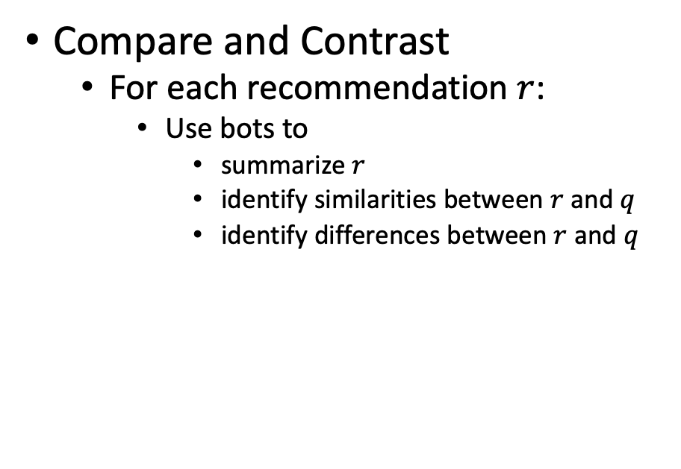
A Few Use Cases
Recommendations for query $q$
ChatBots
For readers:
What should I read?
For authors:
What should I cite?
For conference organizers:
Who should review what?
Finding experts:
Who knows?
(Streeter & Lochbaum, 1998)
Compare and Contrast
For each recommendation $r$:
Use bots to
summarize $r$
identify similarities between $r$ and $q$
identify differences between $r$ and $q$

Slide 5
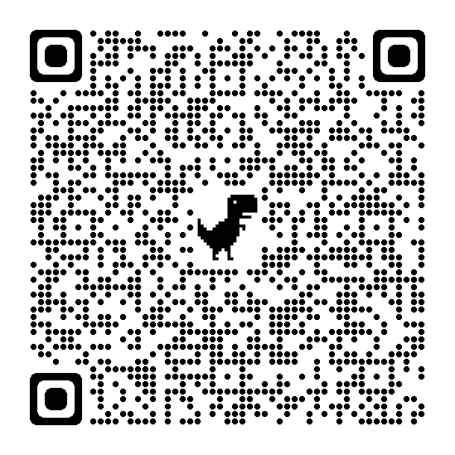
Recommendation API is Super-Easy
Example of S2 (Semantic Scholar) API
https://api.semanticscholar.org/recommendations/v1/papers/forpaper/21321bad706a9f9dbb502588b0bb393cf15fa052?from=all-cs&fields=title,externalIds,citationCount
query: 21321bad706a9f9dbb502588b0bb393cf15fa052
A paper id on Semantic Scholar
Returns recommendations (papers similar to query)
Queries and documents are embedded as vectors
Using Specter, a BERT-like deep net
Search is based on Approximate Nearest Neighbors (FAISS)
from=all-cs: limits search to computer science (about 10% of S2 collection)

Slide 6
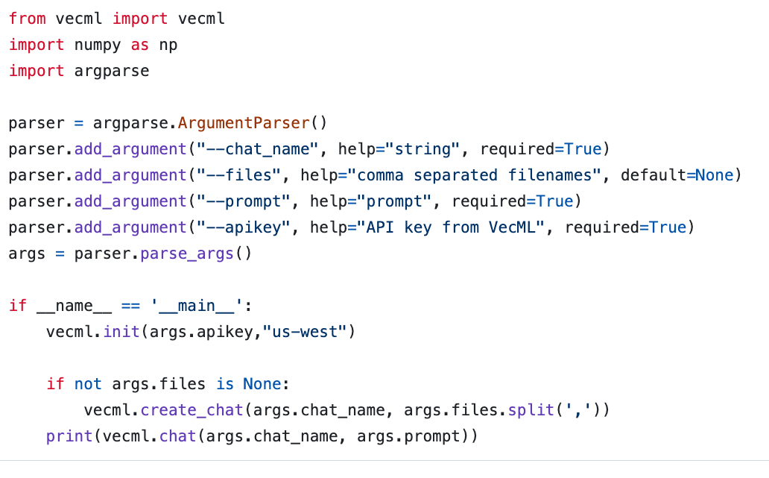
Chatbots are Super-Easy www.vecml.com

Slide 7
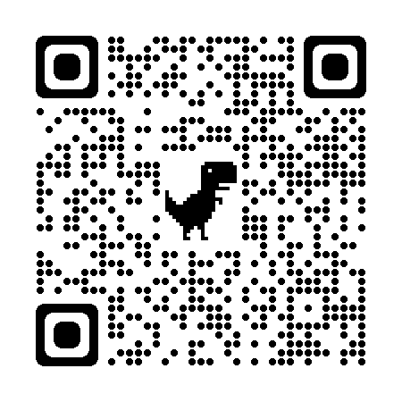
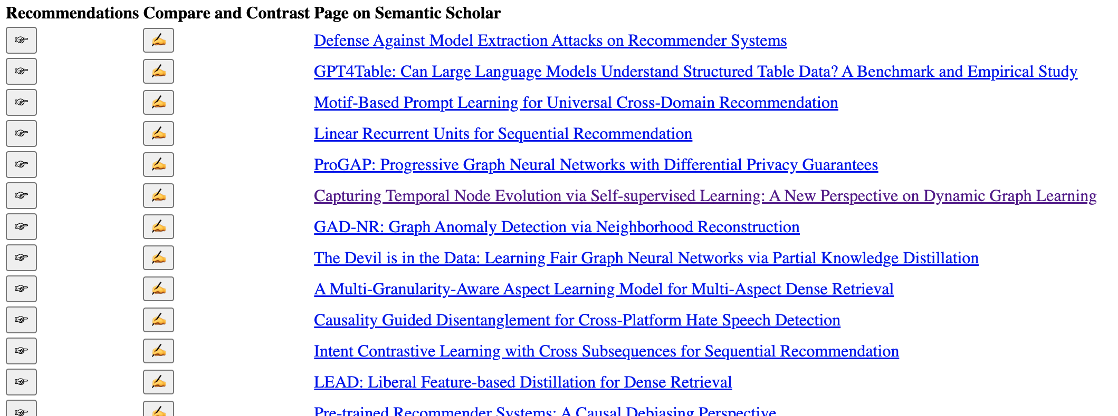
WSDM-2024 Papers on arXiv
S2 API
Chatbot

Slide 8
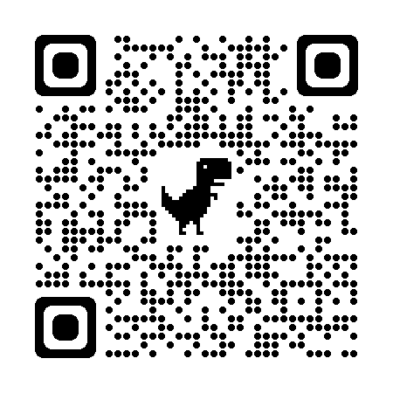
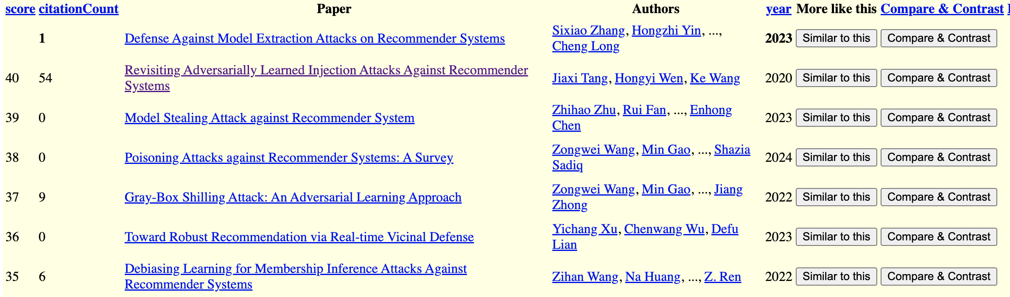
S2 API Recommentations Query: A Paper in WSDM-2024
S2 API
Chatbot

Slide 9
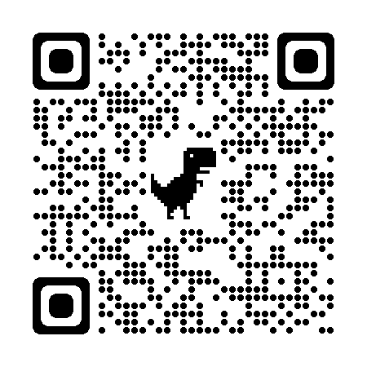
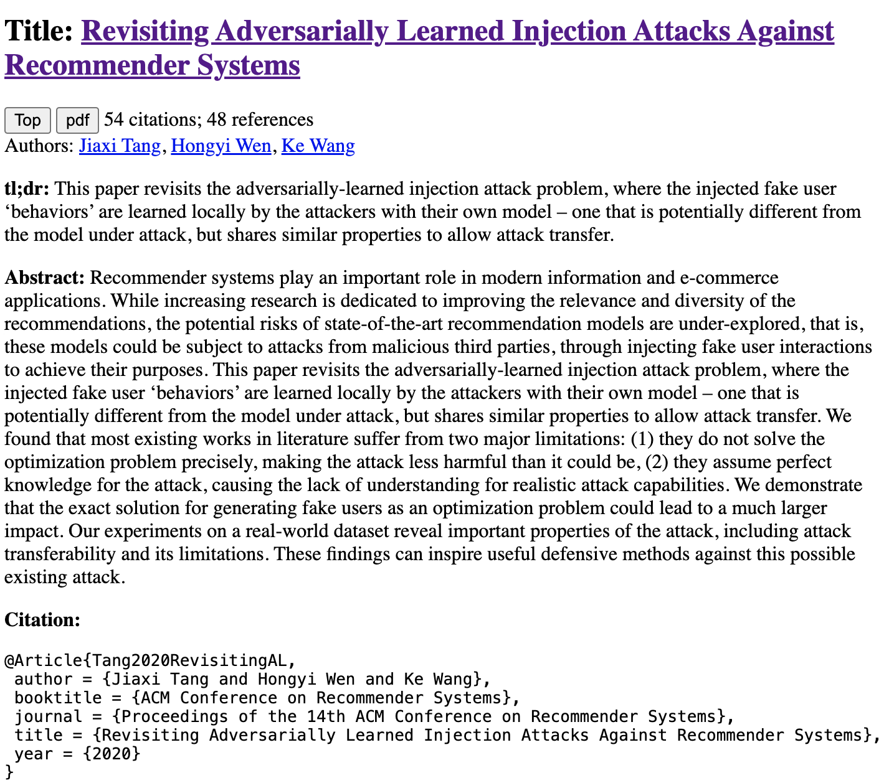
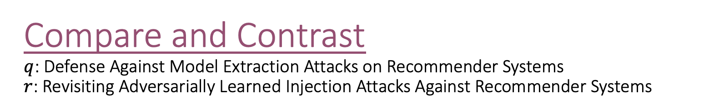
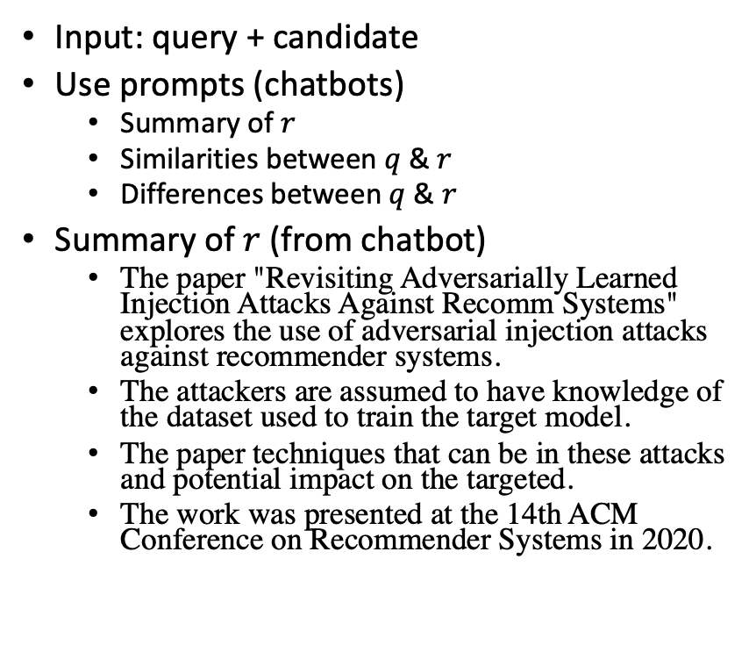
Compare and Contrast $q$: Defense Against Model Extraction Attacks on Recommender Systems $r$: Revisiting Adversarially Learned Injection Attacks Against Recommender Systems
Input: query + candidate
Use prompts (chatbots)
Summary of $r$
Similarities between $q$ & $r$
Differences between $q$ & $r$
Summary of $r$ (from chatbot)
The paper "Revisiting Adversarially Learned Injection Attacks Against Recomm Systems" explores the use of adversarial injection attacks against recommender systems.
The attackers are assumed to have knowledge of the dataset used to train the target model.
The paper techniques that can be in these attacks and potential impact on the targeted.
The work was presented at the 14th ACM Conference on Recommender Systems in 2020.
S2 API
Chatbot

Slide 10

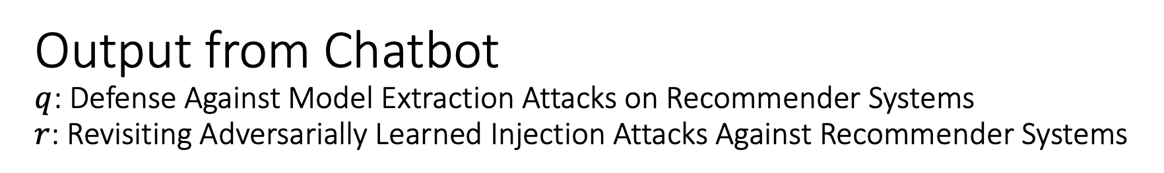

Output from Chatbot $q$: Defense Against Model Extraction Attacks on Recommender Systems $r$: Revisiting Adversarially Learned Injection Attacks Against Recommender Systems
Similarities between $q$ & $r$
Differences between $q$ & $r$
As an Assistant, I can tell you that both
"Revisiting Adversarially Learned Injection Attacks Against Recommender Systems" and
"Defense Against Model Extraction Attacks on Recommender Systems”
focus on security aspects of recommender systems.
The first paper explores injection attacks
where the attacker manipulates the recommendation model by injecting malicious data,
while the second paper deals with defending against model extraction attacks aimed at extracting sensitive information from the recommender system.
Both papers highlight the importance of
addressing security vulnerabilities in recommender systems to protect user data and
maintain the integrity of the recommendation models.
"Revisiting Adversarially Learned Injection Attacks Against Recommender Systems"
focuses on exploring adversarially learned injection attacks against recommender systems,
where the attacker has knowledge about the dataset used to train the target recommendation model.
On the other hand, "Defense Against Model Extraction Attacks on Recommender Systems"
focuses on strategies to defend against model extraction attacks,
where attackers try to extract the architecture or parameters of a recommender system.
The former paper deals with adversarial attacks,
while the latter focuses on defense mechanisms against a different type of attack.
sim?
diff?

Slide 11
Take-Away Message: If you are a researcher or practitioner
What can you do right now without too much effort
Off-the-Shelf APIs
Off-the-Shelf Chatbots
Use case: Academic search domain
Recommendations
Compare and Contrast
If you are developing a web site or an app on a phone,
It is super-easy to use off-the-shelf APIs and chatbots

Slide 12
Easy: NLP
Prompt engineering
Inference (predict)
Fine-tuning (fit)

Slide 13
Prompt Engineering (and disintermediating web-search)
Super-Popular (100+ million users)
Most successful (rapid) adoption of any web app ever
Super-Easy
Easier than Fine-Tuning (and Inference)
Use Cases
“Helping” with homework:
Cheating (?)
Documentation:
Alternative to stack overflow

Slide 14
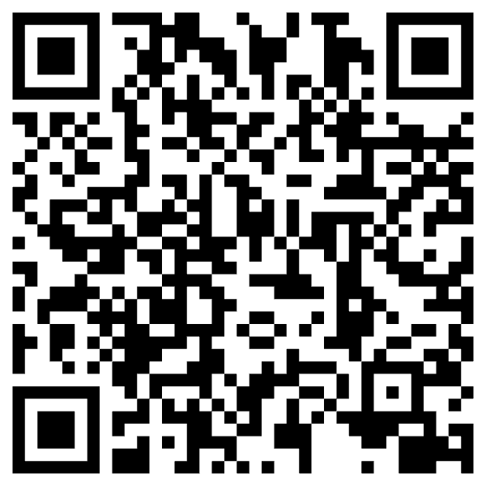
“Helping” with homework: Cheating (?)
Collaborate with students on essays
You have no idea how much we’re using ChatGPT
Cheating?
ChatGPT is better for some tasks
Good: thesis statements, outlines
Bad: capture student’s voice
Worse: quotes
Learning opportunity:
How to decompose writing to subtasks
Collaboration is great,
but student is responsible for end-product

Slide 15
Disintermediating Google, Stack Overflow
Google → Stack Overflow → Instant Answers → ChatBot

Slide 16
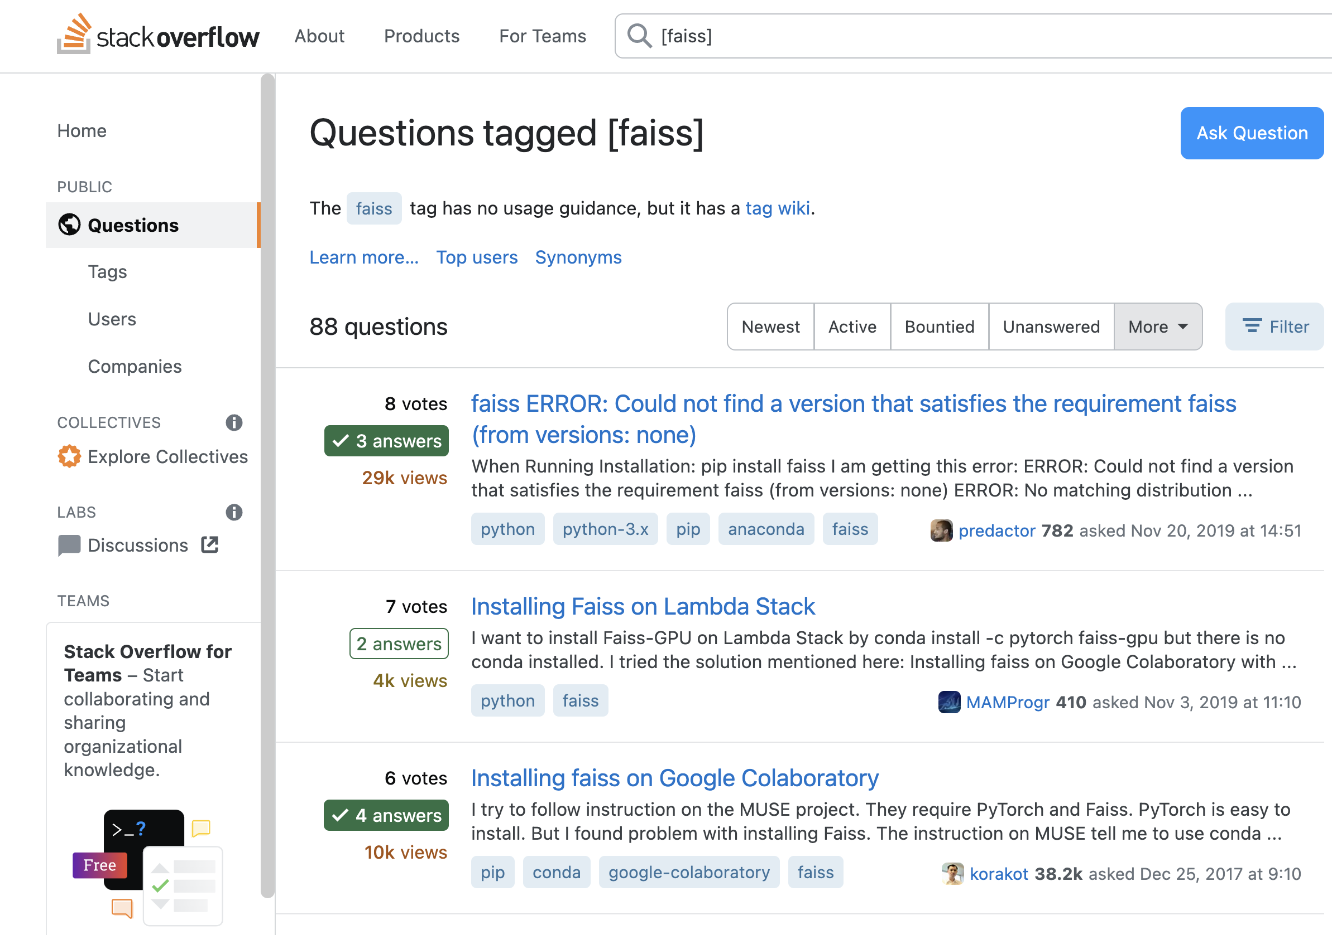

Slide 17
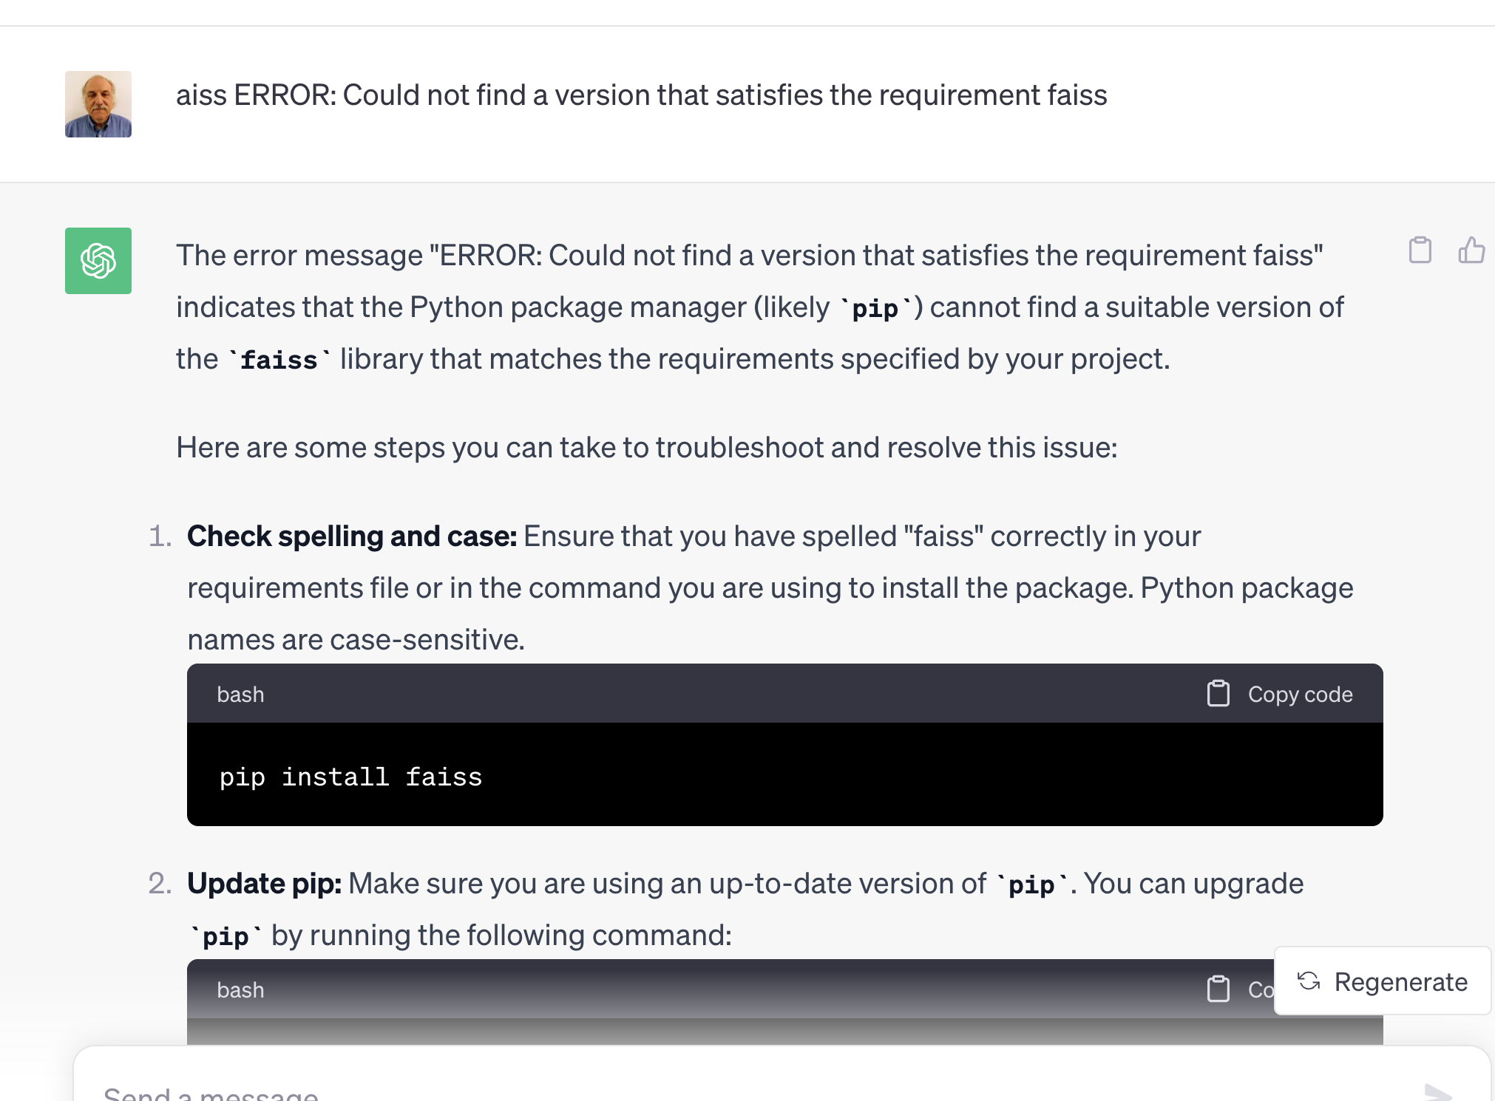
Replacing Stack Overflow with ChatGPT

Slide 18
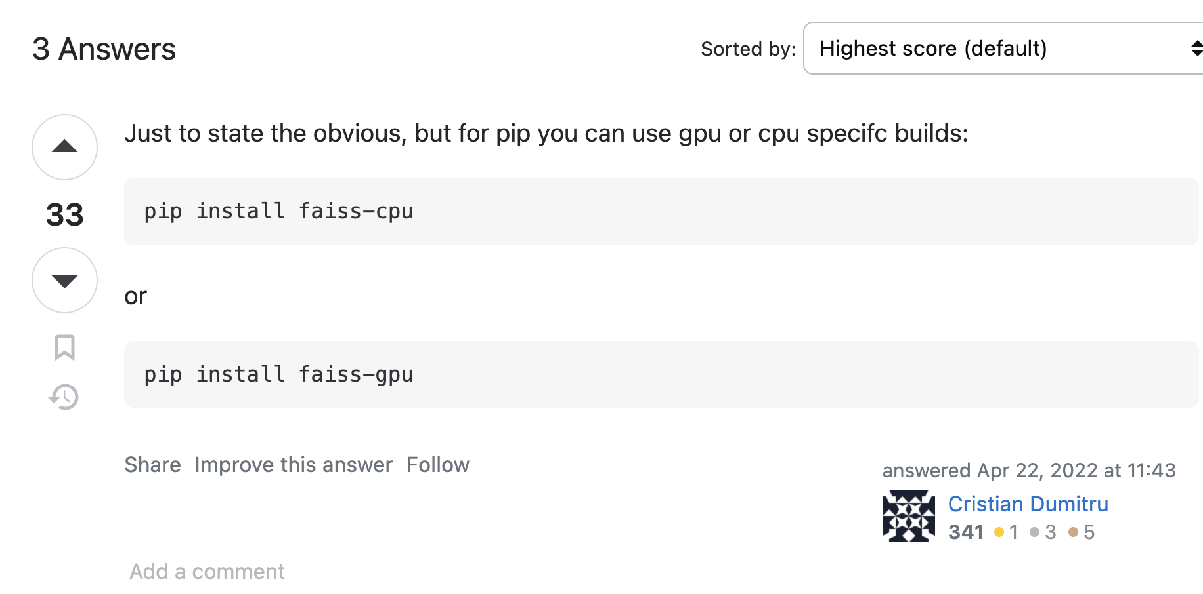
I may be old-fashioned, but I still use Stack Overflow…
Advantages of Stack Overflow
Behavioral signals: logs, votes
Wisdom of the crowd
Feedback to developers
Bug Reports
with stats (prioritization)
and workarounds (with votes)
Web search
Solitaire
Multi-player game (auction)
If we lose stack Overflow
Developers will suffer
Where does ChatGPT get its content?
Stack Overflow?

Slide 19
Decomposing a big problem into subtasks
(Not Easy)

Slide 20
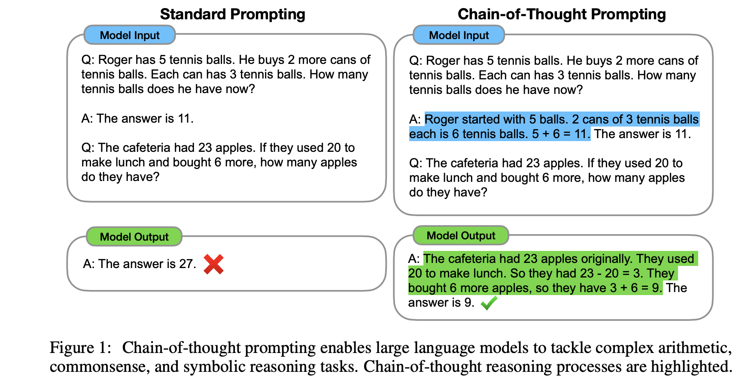

Slide 21
Limitations
Decomposing Problems
Hypothetical
Chain-of-Thought Prompting
works because...
ChatGPT needs help decomposing problems into subtasks
Suppose ChatGPT
can add two small numbers
But for large numbers,
it makes up answers
After each release,
“small” gets “bigger”
(We will return to this later)

Slide 22
Easy: NLP
Prompt engineering
Inference (predict)
Fine-tuning (fit)

Slide 23
Standard 3-Step Recipe
Step | Description | Time | Hardware
1
2
3 | Inference (predict) | Seconds/Minutes | 0+ GPUs
Easy

Slide 24
Standard 3-Step Recipe
Most users should not do this themselves
Step | Description | Time | Hardware
1 | Pre-Training | Days/Weeks | Large GPU cluster
2
3 | Inference (predict) | Seconds/Minutes | 0+ GPUs

Slide 25
Standard 3-Step Recipe
Step | Description | Time | Hardware
1 | Pre-Training | Days/Weeks | Large GPU cluster
2 | Fine-Tuning (fit) | Hours/Days | 1+ GPUs
3 | Inference (predict) | Seconds/Minutes | 0+ GPUs
Not Hard

Slide 26
Inference (predict)

Slide 27
“Easy Inference”
Replication
Plenty of Room for Improvement
Many students should be able to
Download models from hubs
And use them as intended
To do many useful things
Especially on first impression,
It is impressive how much
can be accomplished
with “easy inference”
But there is always
more work to do
Current solutions are
unlikely to stand up to test of time

Slide 28
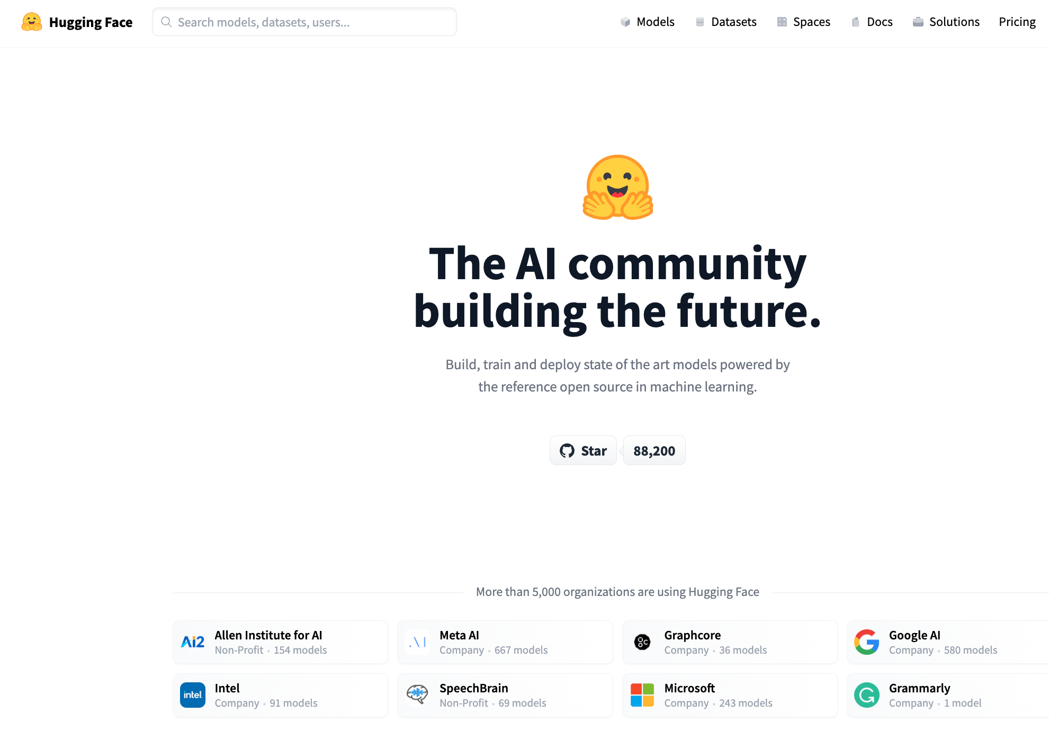

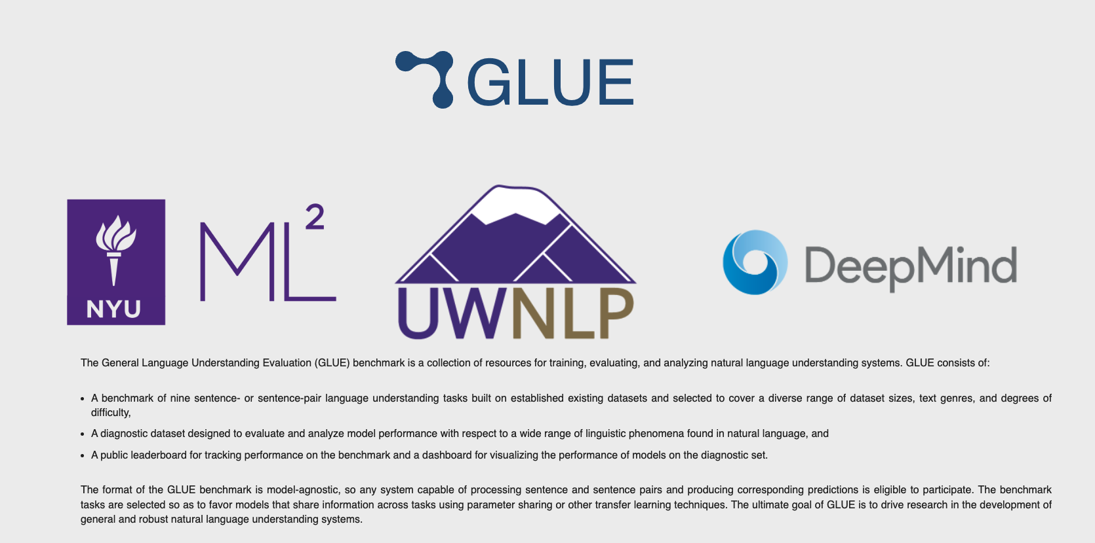
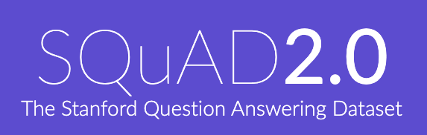

Resources
DataSets (Benchmarks)
Hubs
Examples
GLUE (NYU)
SQuAD (Stanford)
Features
Splits:
Test, Validation (Dev), Train
Metrics
Leaderboard
Examples
HuggingFace https://huggingface.co/
PaddleHub (Baidu, China)
Features
Datasets (50k)
Models (300k)
Apps (100k)
Community Engagement
(Social Media)
Growing Quickly
($≈10$x/year)

Slide 29

Easy: Inference (Colab) HuggingFace Pipelines
See here for a list of currently supported tasks
machine learning:
classification, regression,
token classification,
classify spans (Q&A), fill mask
speech:
speech-to-text (automatic speech recognition (ASR)),
text-to-speech (speech synthesis)
audio classification
vision:
image classification, video classification, image segmentation, image to text, visual question answering
natural language:
text classification
question answering
fill mask (Cloze task)
machine translation (MT)
feature extraction

Slide 30
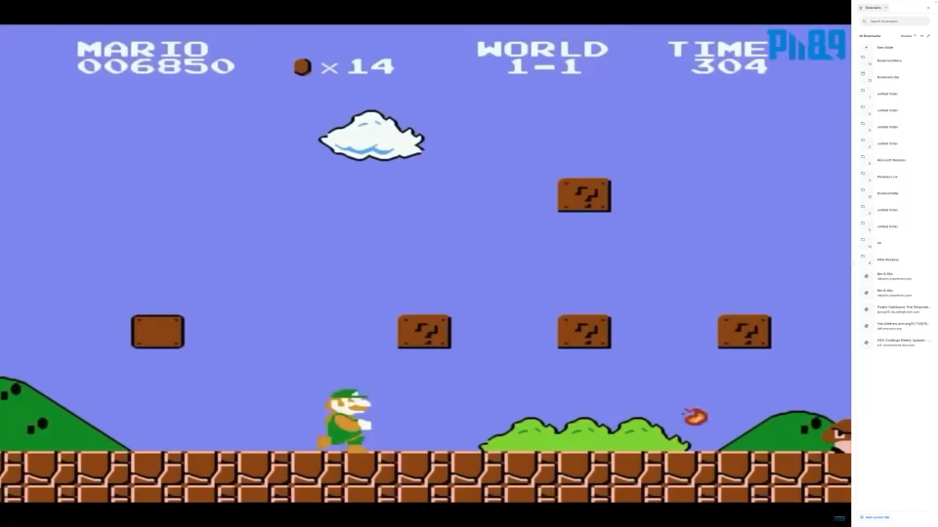
Test of time: Inference is cool (for now)
https://youtu.be/rLl9XBg7wSs

Slide 31

Test of time: Inference is cool (for now) Will you still love me when I’m Sixty Four?
https://www.youtube.com/watch?v=wUDRIC5RSX4

Slide 32
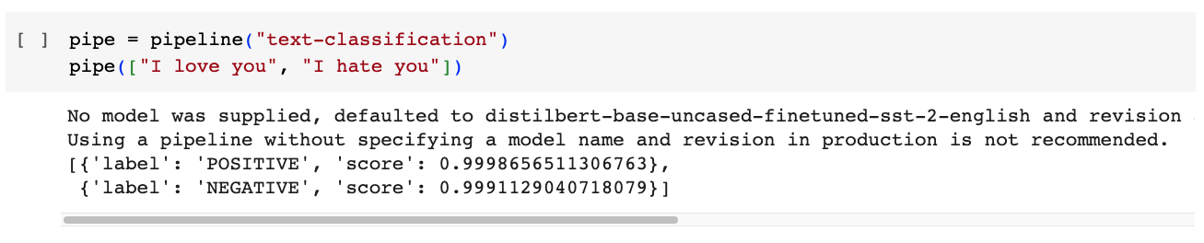
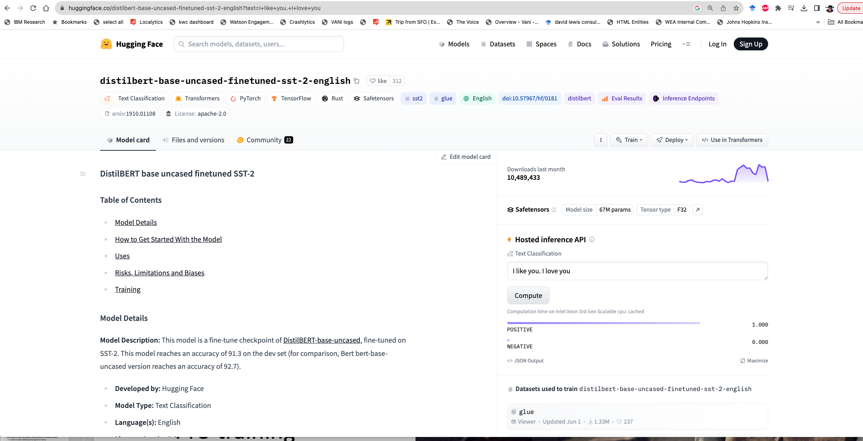
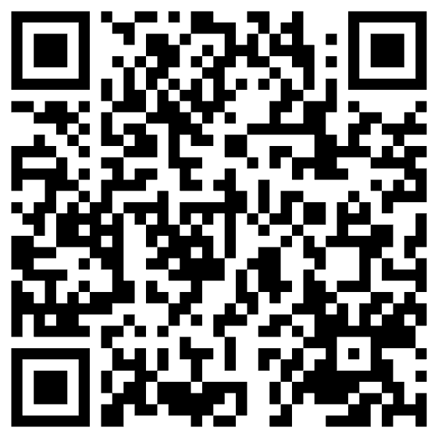

Slide 33
Input: I love you Output: Depends on Model (among other things)
Task: classify
Models:
Sentiment
Expected output label: positive
Fake News:
Expected output label: not fake (real)
Spam/Ham:
Expected output label: not spam (ham)
for model in …
do
echo I love you |
gft_predict \
--task classify \
--model $model
done

Slide 34
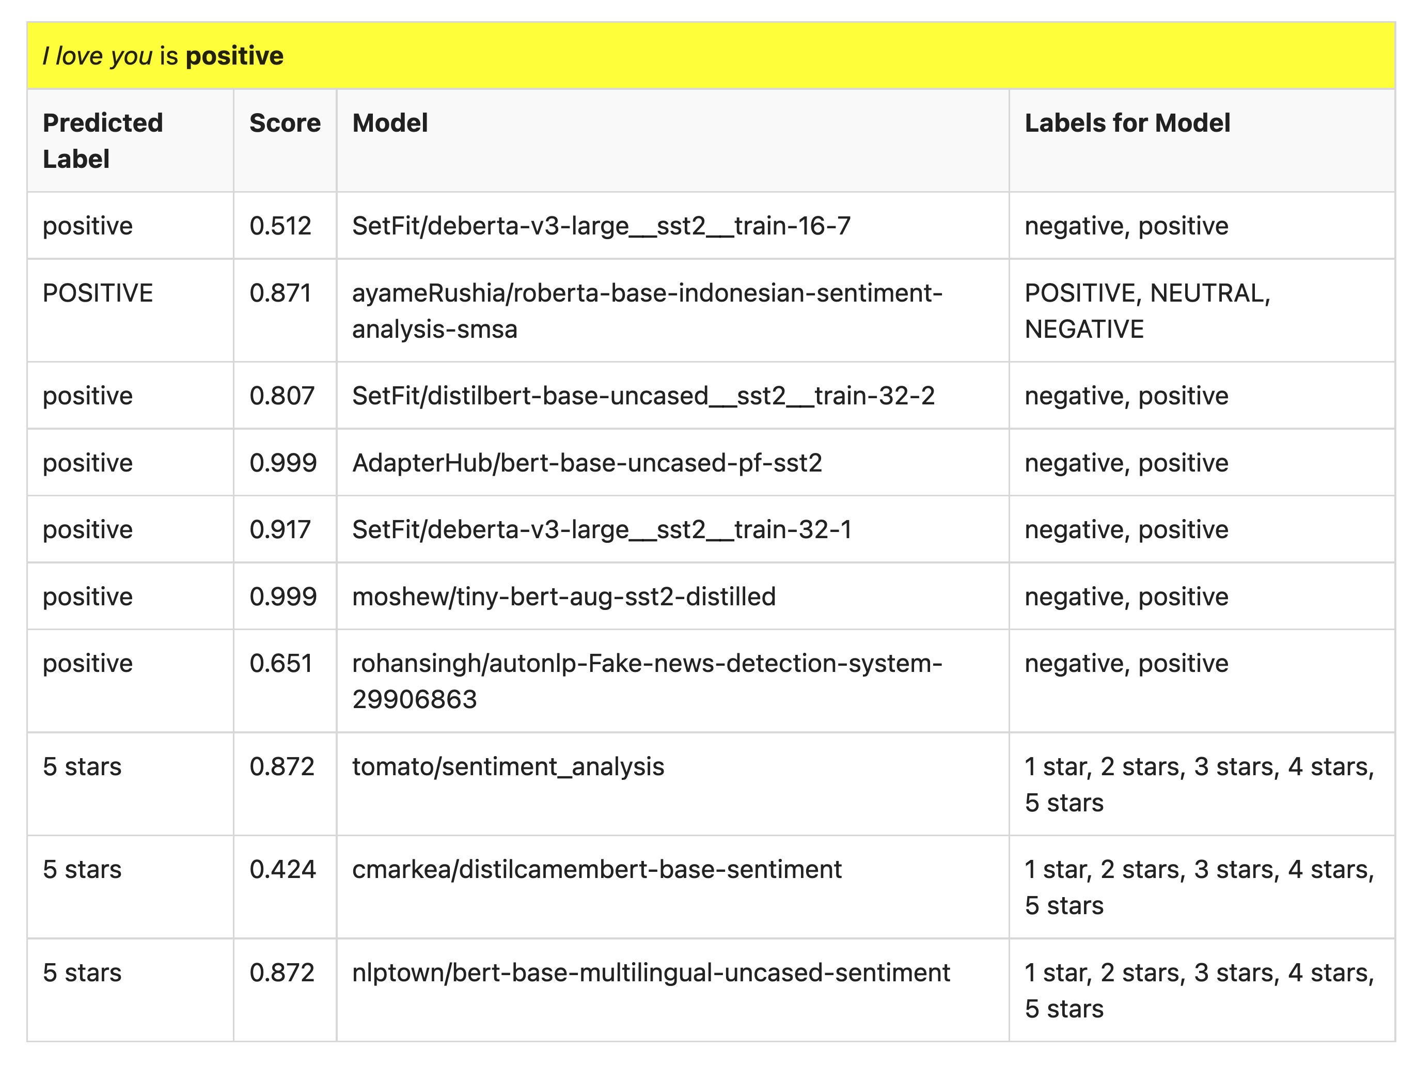
Many of these models produce reasonable results
Scores could be more confident

Slide 35
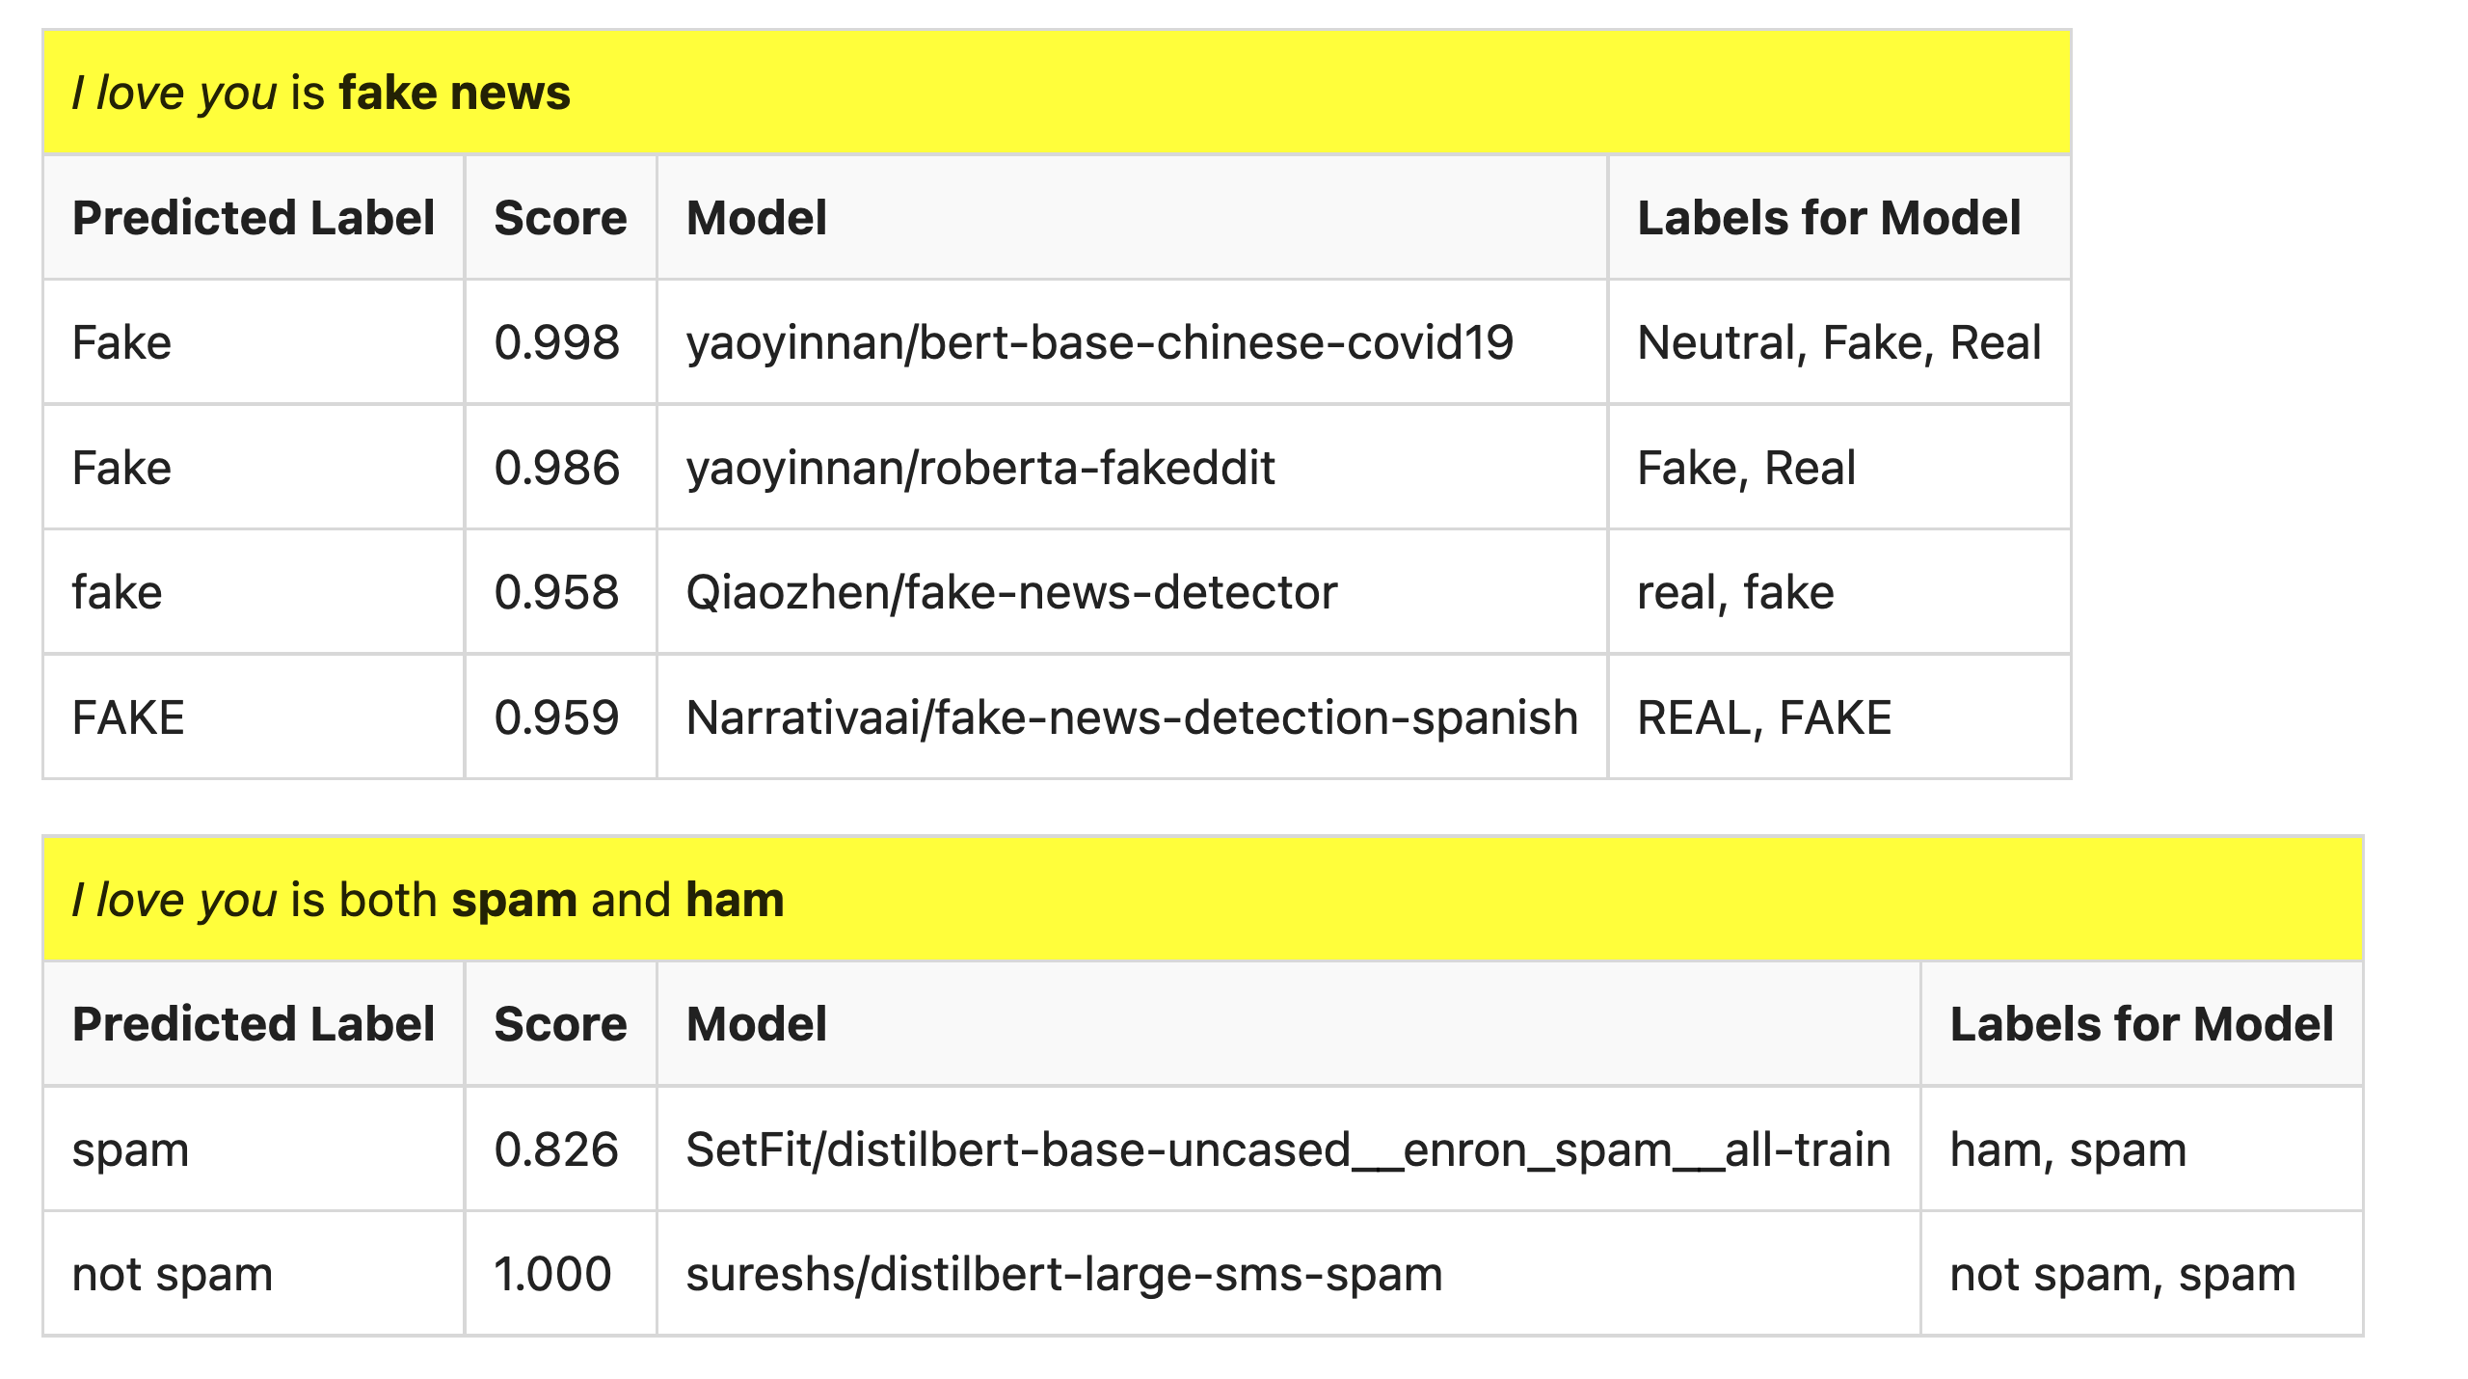
But…

Slide 36

What is a label?
Spam email?
Label: yes, no

Slide 37
Ugly: Challenges for Classification
Benchmarks are small, clean, unrealistic…
Arms race, Adversarial attacks (GANs),
Labeling is not as easy as it might seem
Depends on context
Consider: adult content
Parents posted innocent videos of their kids on YouTube
But these videos went viral among not-so-innocent audience
Incentives:
If toxicity is profitable,
then use classifiers in reverse direction
to maximize toxicity (and profits)

Slide 38
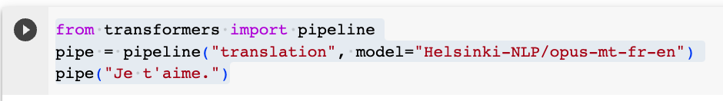
Another Example of Inference: Machine Translation (MT)

Slide 39
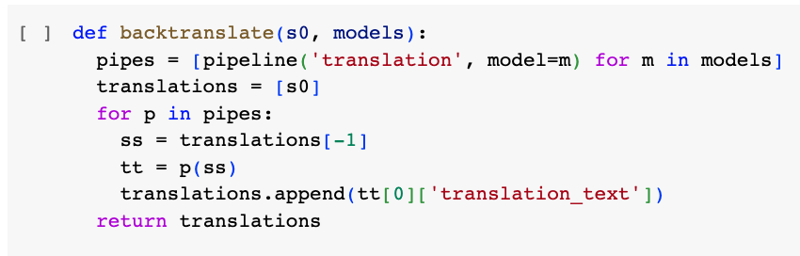
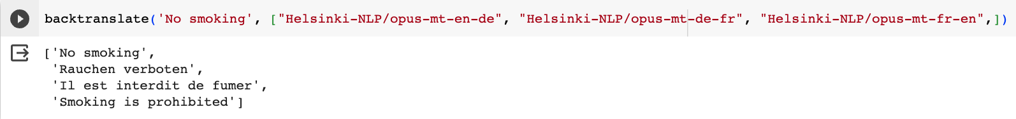
Back Translation

Slide 40
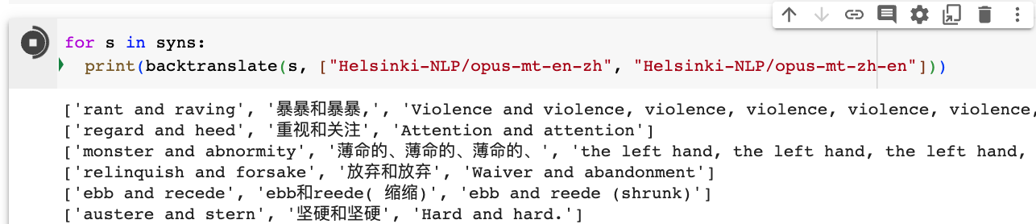
Back Translation of Synonyms

Slide 41
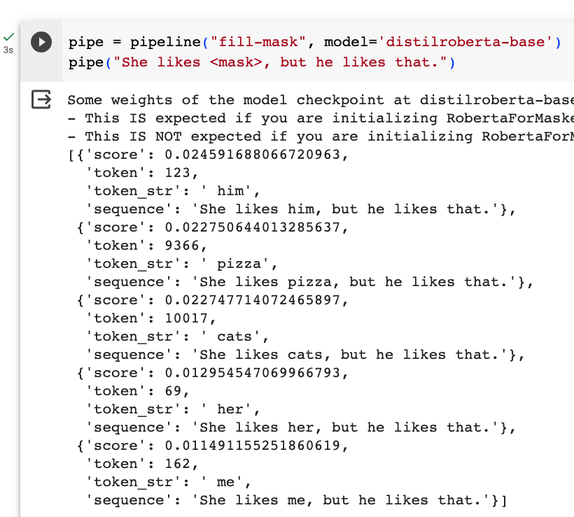
Fill Mask (Cloze Task)

Slide 42
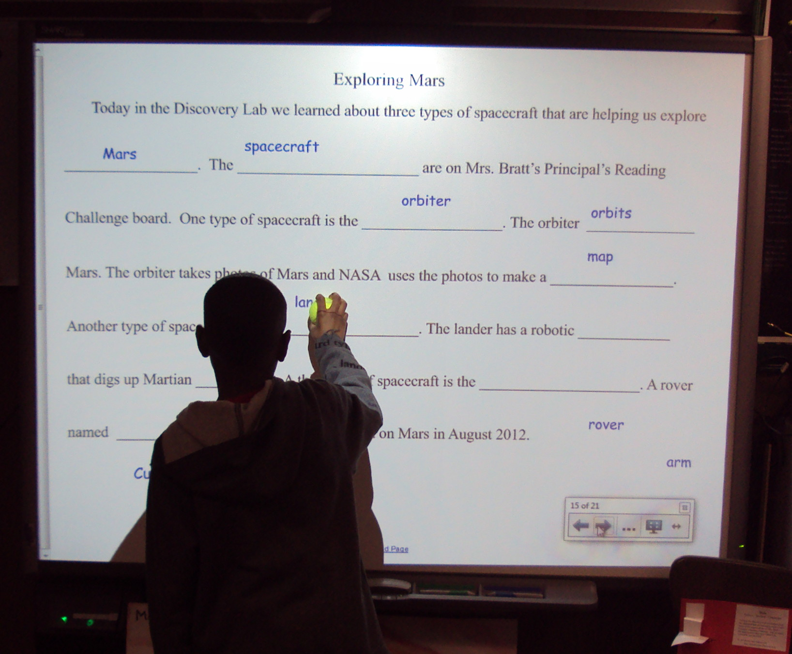
More Inference Tasks: Classification, Fill Mask, … echo … | gft_predict –task fill-mask
BERT: Fill-Mask (Delvin et al, 2019)
Cloze Task (1953)
Input | Choice 1 |  | Choice 2
I <mask> you | miss | 30% | love | 17%
I <mask> him | love | 14% | miss | 13%
I <mask> her | love | 16% | miss | 12%
I love <mask> | him | 2% | cats | 2%
I <mask> New York | love | 33% | miss | 17%
I love the <mask> guy | pizza | 2% | funny | 2%
I hate the <mask> guy | fucking | 3% | pizza | 2%
By Laurie Sullivan - DSC01784, CC BY 2.0, https://commons.wikimedia.org/w/index.php?curid=62727253

Slide 43
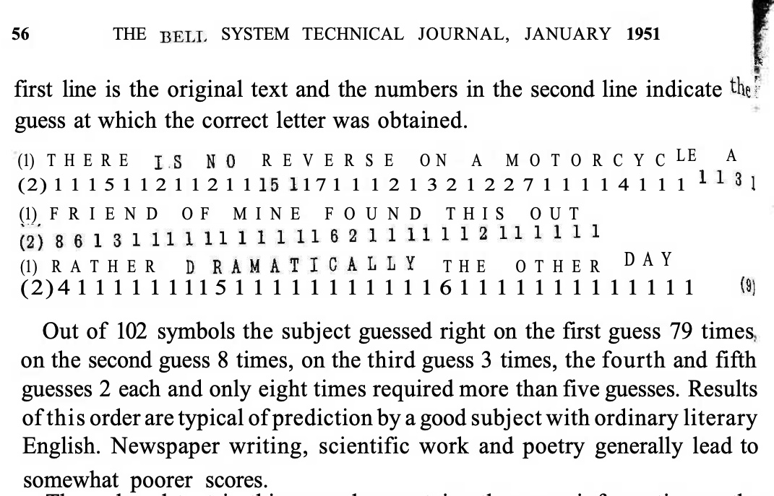
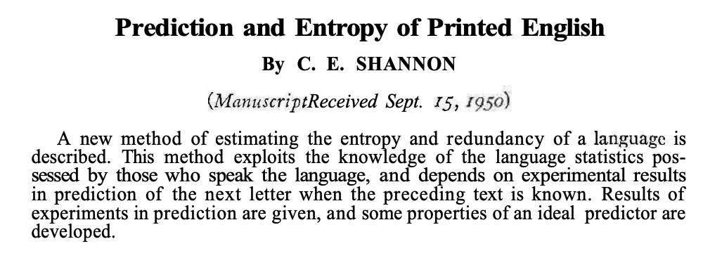
Lots of History: Fill-mask, Cloze Task, Entropy

Slide 44
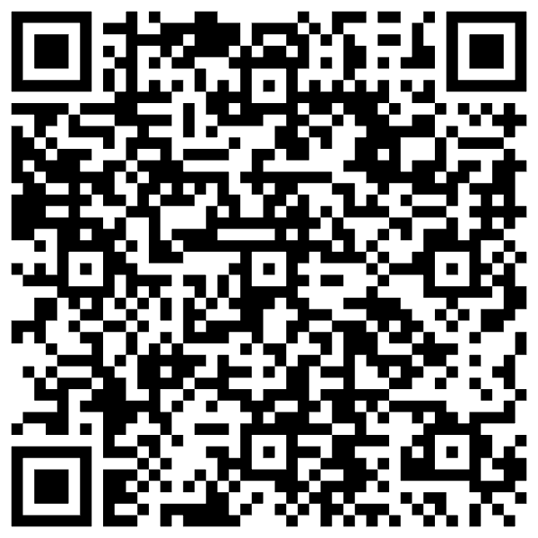
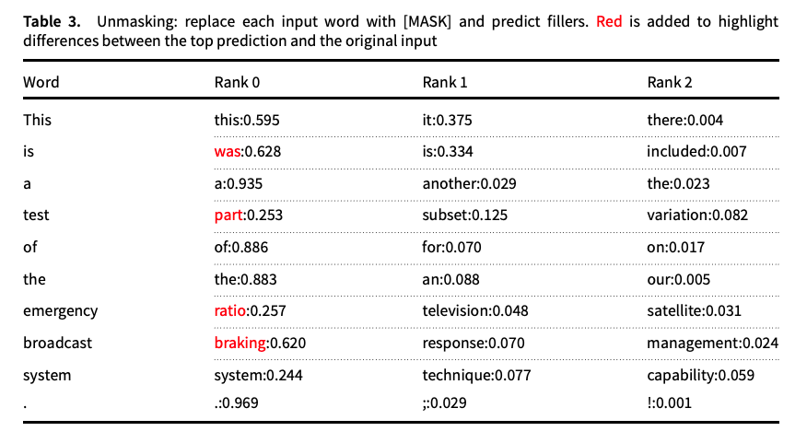
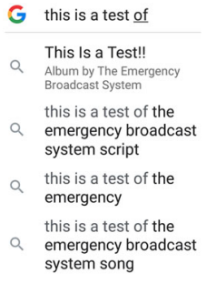
Guess the missing word in a cliché (from “Emerging trends: Deep nets for poets”)
Fill Mask
Autocomplete in Search

Slide 45
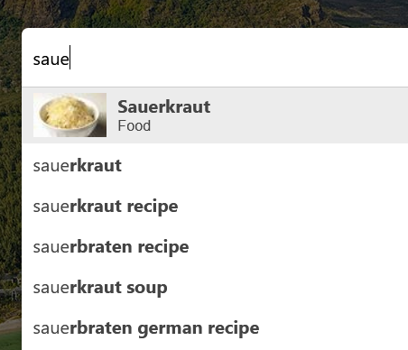
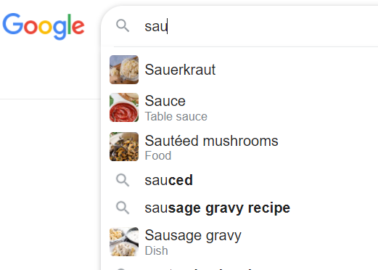

Autocomplete $≠$ Fill-Mask

Slide 46
Massive Growth → Mistaken Impression that everything is new (and there is no history)
Scientific literature doubles every 9 years (90% written since I started PhD)
What’s new
The world is taking notice (in AI)
Fluency is much improved
What’s not new
Chatbots (and much of the tech)
SOTA-Chasing
New/better shiny objects
(with same old quality?)
Does SOTA-Chasing → Progress?
Trustworthiness is still open

Slide 47
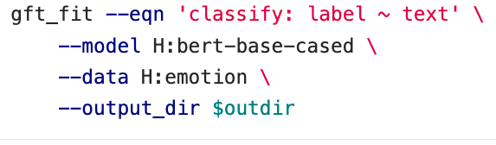
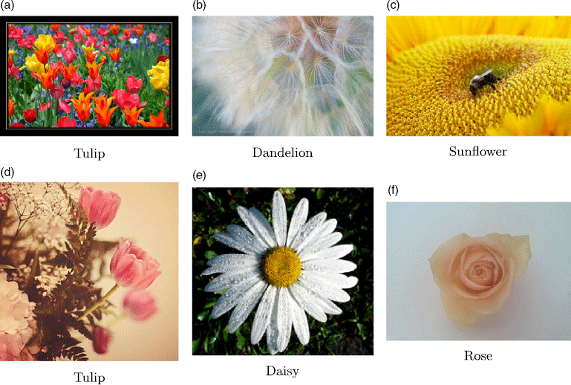
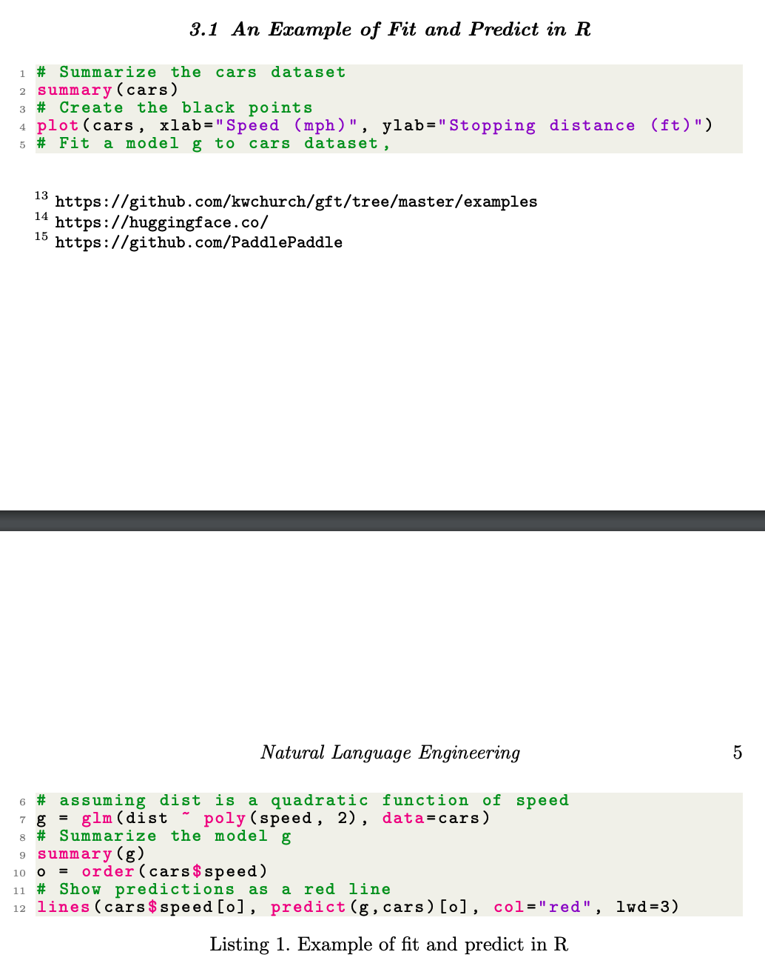
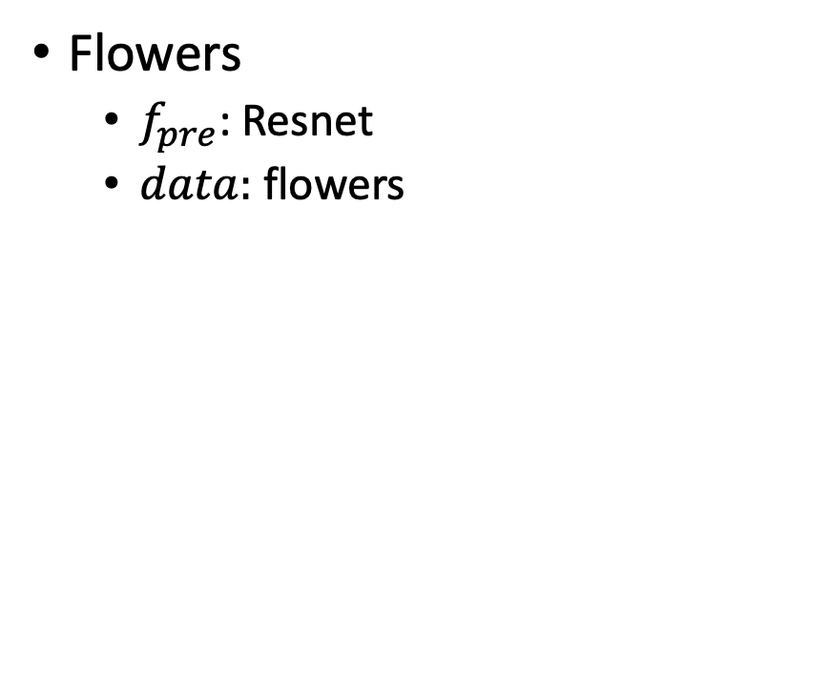
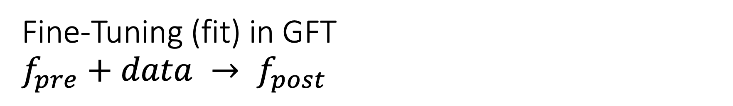
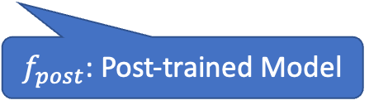
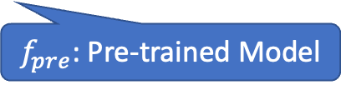
Fine-Tuning (fit) in GFT $f_{pre}+data → f_{post}$
Flowers
$f_{pre}$: Resnet
$data:$flowers
$f_{pre}$: Pre-trained Model
$f_{post}$: Post-trained Model
Fine-Tuning (fit) in R

Slide 48

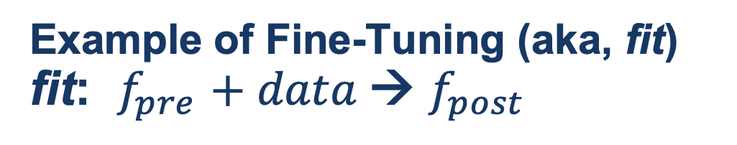
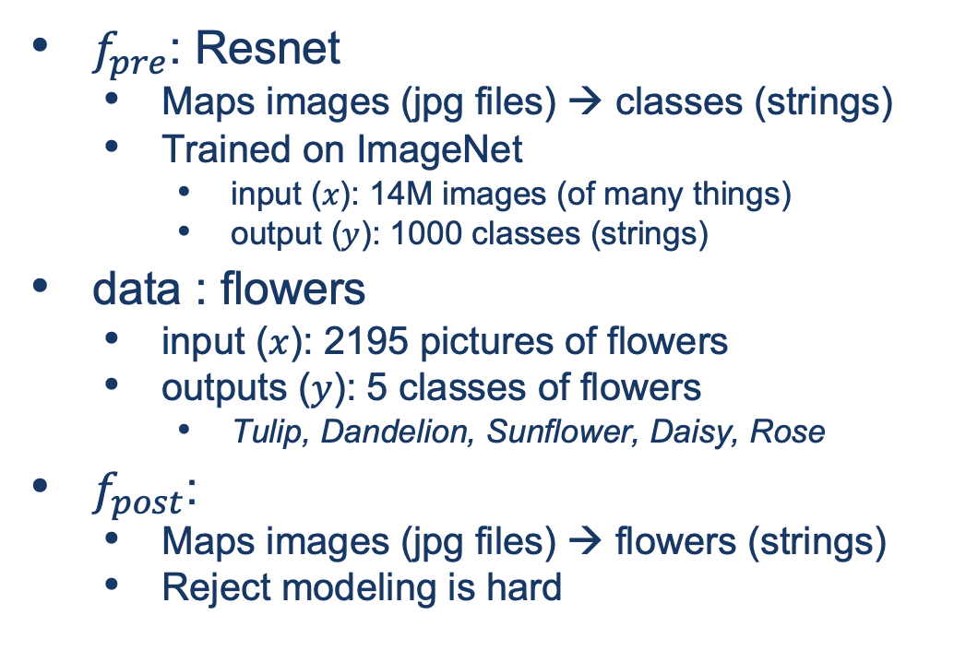
Guide Book App

Slide 49
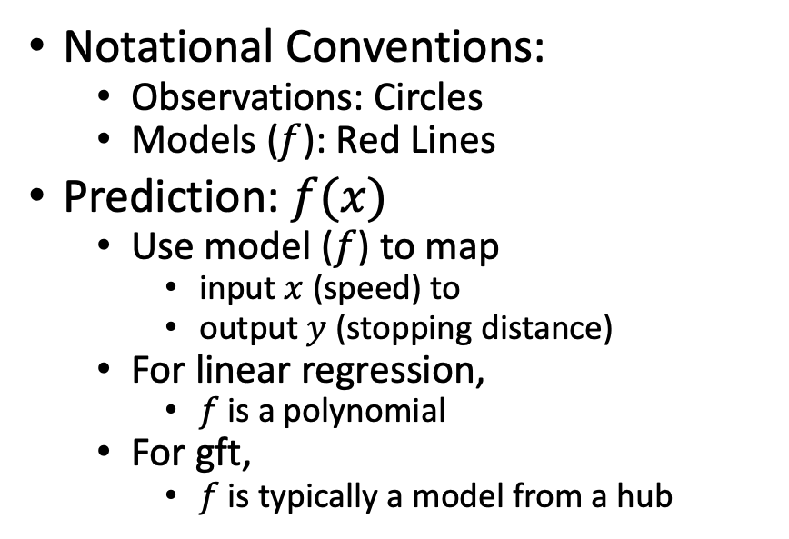
Fine-Tuning (Fit) in R (Statistics Package)
Make deep nets look like regression
(Not much programming)
Black Points:
cars dataset
Notational Conventions:
Observations: Circles
Models ($f$): Red Lines
Prediction: $f(x)$
Use model ($f$) to map
input $x$ (speed) to
output $y$ (stopping distance)
For linear regression,
$f$is a polynomial
For gft,
$f$is typically a model from a hub
Red Line:
Model (f)

Slide 50

Datasets Example: Cars
Two Columns:
cars$speed
cars$dist

Slide 51



Example of Datasets in HuggingFace https://huggingface.co/datasets/dair-ai/emotion
$$x$$
$$y$$

Slide 52

Emotion → GLUE (Cola) https://huggingface.co/datasets/glue/viewer/cola/train
Terminology: Splits
Terminology: Subset

Slide 53

glm (General Linear Models) in R (and Sklearn)
glm: fit poly model with data
predict: $dist ≈ g(cars\$speed)$

Slide 54


Emotion Dataset $$classify:label\sim text$$
Task/Loss
Columns
Columns
Row

Slide 55


Fine-Tuning (fit): Numerous Use Cases $f_{pre}+data → f_{post}$
Flowers
$f_{pre}$: Resnet
$data:$flowers
Emotion Classification
$f_{pre}$: https://huggingface.co/bert-base-uncased
$data:https://huggingface.co/datasets/dair−ai/emotion$
GLUE
SQuAD
Machine Translation
Speech Recognition
Vision
and much more
$f_{pre}$: Pre-trained Model
$f_{post}$: Post-trained Model
Fine-Tuning (fit) in R

Slide 56
GLUE Subsets
GLUE COLA SUBSET
Sentence | Label
Bill sang himself to sleep. | 1 (acceptable)
Bill squeezed the puppet through the hole. | 1 (acceptable)
Bill sang Sue to sleep. | 1 (acceptable)
The elevator rumbled itself to the ground. | 0 (unacceptable)
If the telephone rang, it could ring itself silly. | 1 (acceptable)
She yelled hoarse. | 0 (unacceptable)
Ted cried to sleep. | 0 (unacceptable)
The tiger bled to death. | 1 (acceptable)
Subset | Dataset
COLA | H:glue,cola
SST2 | H:glue,sst2
WNLI | H:glue,wnli
MRPC | H:glue,mrpc
QNLI | H:glue,qnli
QQP | H:glue,qqp
SSTB | H:glue,sstb
MNLI | H:glue,mnli

Slide 57

GFT Program for COLA
GLUE COLA SUBSET
Sentence | Label
Bill sang himself to sleep. | 1 (acceptable)
Bill squeezed the puppet through the hole. | 1 (acceptable)
Bill sang Sue to sleep. | 1 (acceptable)
The elevator rumbled itself to the ground. | 0 (unacceptable)
If the telephone rang, it could ring itself silly. | 1 (acceptable)
She yelled hoarse. | 0 (unacceptable)
Ted cried to sleep. | 0 (unacceptable)
The tiger bled to death. | 1 (acceptable)
https://github.com/kwchurch/gft/blob/master/examples/fit_examples/model.HuggingFace/language/data.HuggingFace/glue/cola.sh

Slide 58

Simple Equations Cover Many Cases of Interest GLUE: A Popular Benchmark
Subset | Dataset | Equation
COLA | H:glue,cola | $$classify : label \sim sentence$$
SST2 | H:glue,sst2 | $$classify : label \sim sentence$$
WNLI | H:glue,wnli | $$classify : label \sim sentence$$
MRPC | H:glue,mrpc | $$classify : label \sim sentence1 + sentence2$$
QNLI | H:glue,qnli | $$classify : label \sim sentence1 + sentence2$$
QQP | H:glue,qqp | $$classify : label \sim question+sentence$$
SSTB | H:glue,sstb | $$regress : label \sim question1+question2$$
MNLI | H:glue,mnli | $$classify : label \sim premise+hypothesis$$

Slide 59


Equation Keywords $≈$ Pipeline Tasks
Benchmark | Subset | Dataset | Equation
GLUE | COLA | H:glue,cola | $$classify : label \sim sentence$$
SQuAD 1.0 |  | H:squad | $$classify_spans:answers\sim question+context$$
SQuAD 2.0 |  | H:squad_v2 | $$classify_spans:answers\sim question+context$$
CONLL2003 | POS | H:conll2003 | $$classify_tokens:pos_tags\sim tokens$$
 | NER | H:conll2003 | $$classify_tokens:ner_tags\sim tokens$$
TIMIT |  | H:timit_asr | $$ctc :text\sim audio$$
Amazon Reviews |  | H:amazon_reviews_multi | $$classify : label \sim question+sentence$$
VAD |  | C:$gft/datasets/VAD/VAD | $$regress: Valence + Arousal + Dominance \sim Word$$

Slide 60


gft Cheat Sheet (General Fine-Tuning)
4+1 Functions
4 Arguments
gft_fit: $f_{pre}$ →$f_{post}$(fine-tuning)
4 Arguments, --output_dir, --metric, --splits
(plus most args in most hubs)
gft_predict: $f\left(x\right)→\hat{y}$ (inference)
Input: 4 Arguments ($x$ from data or stdin)
Output: $\hat{y}$ for each $x$
gft_eval: Score model on dataset
Input: 4 Arguments, --split, --metric, …
Output: Score
gft_summary: Find good stuff
Input: 4 Arguments
(may include: __contains__, __infer__)
gft_cat_dataset: Output data to stdout
Input: 4 Arguments (--data, --eqn)
--data
--model
--eqn $task:y\sim x_{1}+x_{2}$
--task
classify (text-classification)
classify_tokens (token-classification)
classify_spans (QA, question-answering)
classify_audio (audio-classification)
classify_images (image-classification)
regress
text-generation
MT (translation)
ASR (ctc, automatic-speech-recognition)
fill-mask

Slide 61

Regression in R: Summarize (almost) anything
Fit a model (g) to data (cars)

Slide 62

Regression in R: Summarize (almost) anything

Slide 63
Regression in R: Summarize (almost) anything
Fit a model (g) to data (cars)
Predict
Summarize a model (g)
Opportunity to Improve g

Slide 64
gft_summary
Summarize almost anything
Models
Datasets

Slide 65





Tasks
$$y∈\left\{0,1,2,…\right\}$$
classify, text-classification
regress
QA, Question Answering, classify spans
token classification
NER (Named Entity Recognition)
POS (Part of Speech Tagging)
translation, MT
ASR, Automatic Speech Recognition, ctc
$y∈ℝ$ or $y∈ℝ^{N}$
$y$ for each start/end of span
$y$ for each token
$y$ for each phoneme

Slide 66

gft Cheat Sheet (General Fine-Tuning)
4+1 Functions
4 Arguments
gft_fit: $f_{pre}$ →$f_{post}$(fine-tuning)
4 Arguments, --output_dir, --metric, --splits
(plus most args in most hubs)
gft_predict: $f\left(x\right)→\hat{y}$ (inference)
Input: 4 Arguments ($x$ from data or stdin)
Output: $\hat{y}$ for each $x$
gft_eval: Score model on dataset
Input: 4 Arguments, --split, --metric, …
Output: Score
gft_summary: Find good stuff
Input: 4 Arguments
(may include: __contains__, __infer__)
gft_cat_dataset: Output data to stdout
Input: 4 Arguments (--data, --eqn)
--data
--model
--eqn $task:y\sim x_{1}+x_{2}$
--task
classify (text-classification)
classify_tokens (token-classification)
classify_spans (QA, question-answering)
classify_audio (audio-classification)
classify_images (image-classification)
regress
text-generation
MT (translation)
ASR (ctc, automatic-speech-recognition)
fill-mask

Slide 67
Easy Conclusions: Inference (Colab) HuggingFace Pipelines
See here for a list of currently supported tasks
machine learning:
classification, regression,
token classification,
classify spans (Q&A), fill mask
speech:
speech-to-text (automatic speech recognition (ASR)),
text-to-speech (speech synthesis)
audio classification
vision:
image classification, video classification, image segmentation, image to text, visual question answering
natural language:
text classification
question answering
fill mask (Cloze task)
machine translation (MT)
feature extraction

